Slide 1
CENTRAL REGION, REGINAL MITTNG
U.P. EAST (OLIVET ZONE)
U.P. EAST COORDINATORS
Coordinator – Sol. Anchal sister
SPEAKER - SOL. NEETU Sister
Deputy speaker – Sol. Reema sister
STAte Security - sol. Reena sister
Sedoparly Secutry - Sol. Sumit
Fellowship Coordinator- sol. Sunita mall

Slide 2
OLIVET ZONE – Coordinator
Coordinator – SOL. AJAY RAHI
SPEAKER – sol. MAHI RAHI
DEPUTY SPEAKE – sol. Madan
Security – sol. Rani

Slide 3
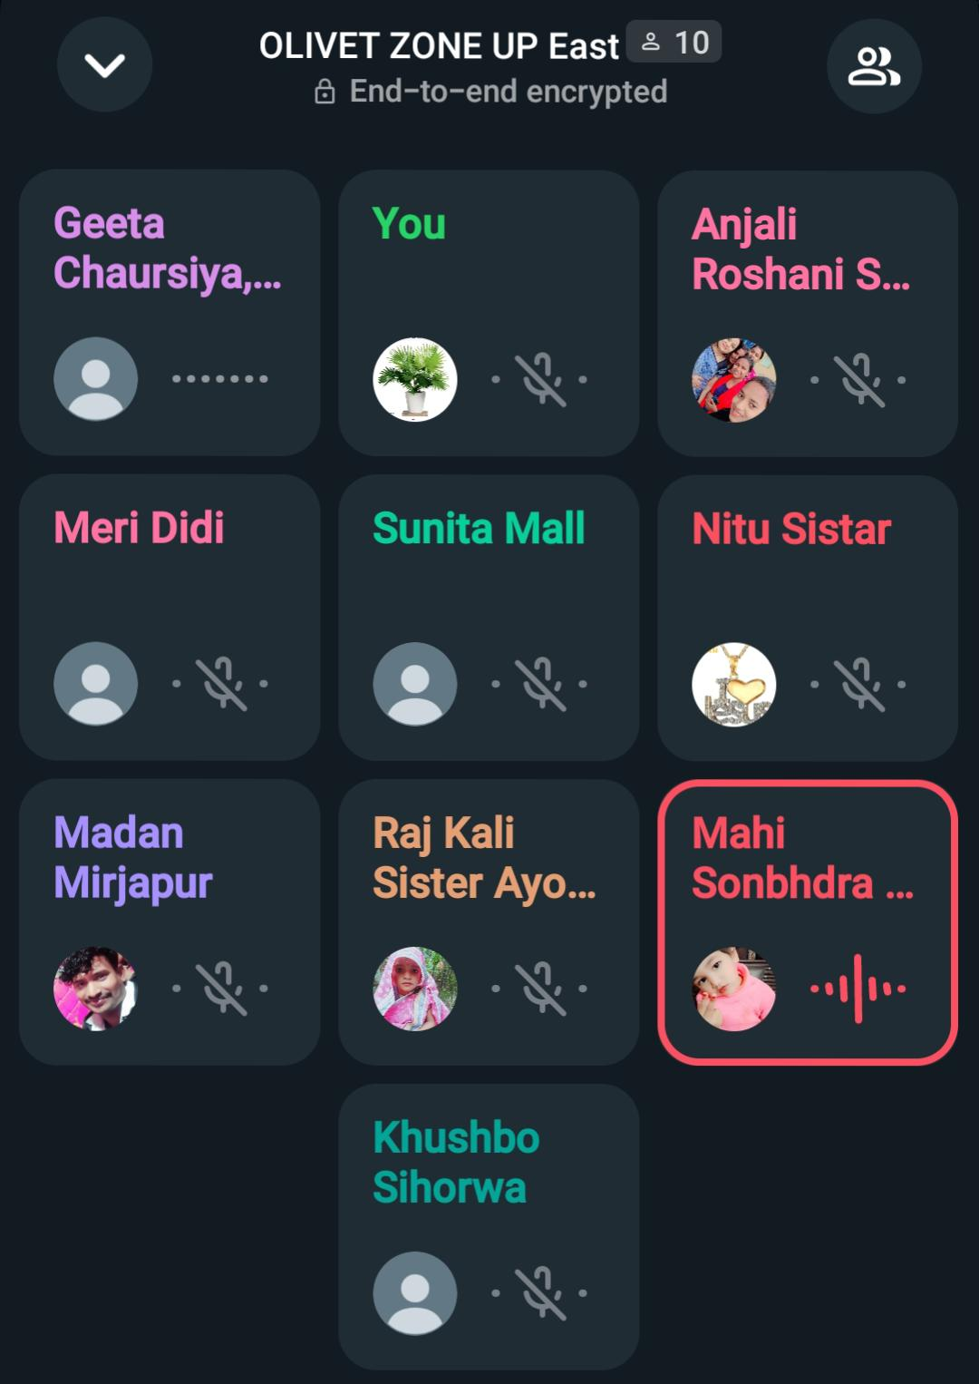
OLIVET zone - activities
DAIly morning prayer

Slide 4
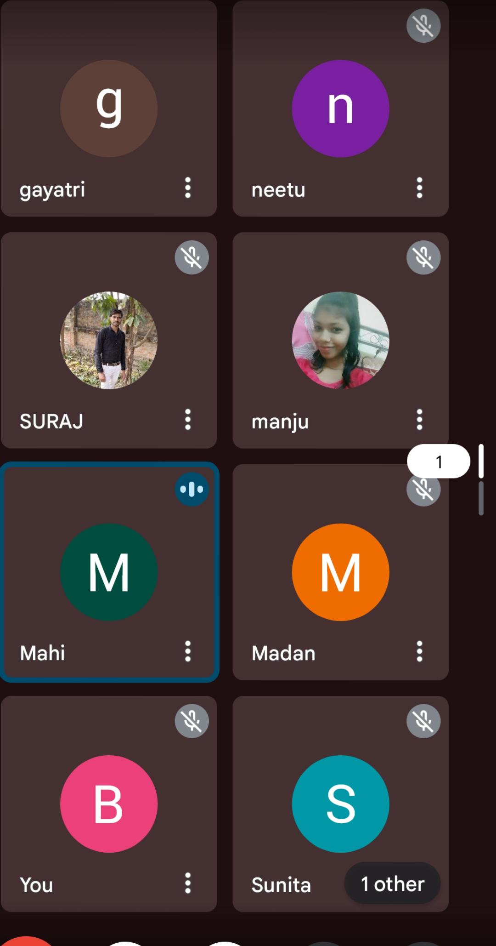
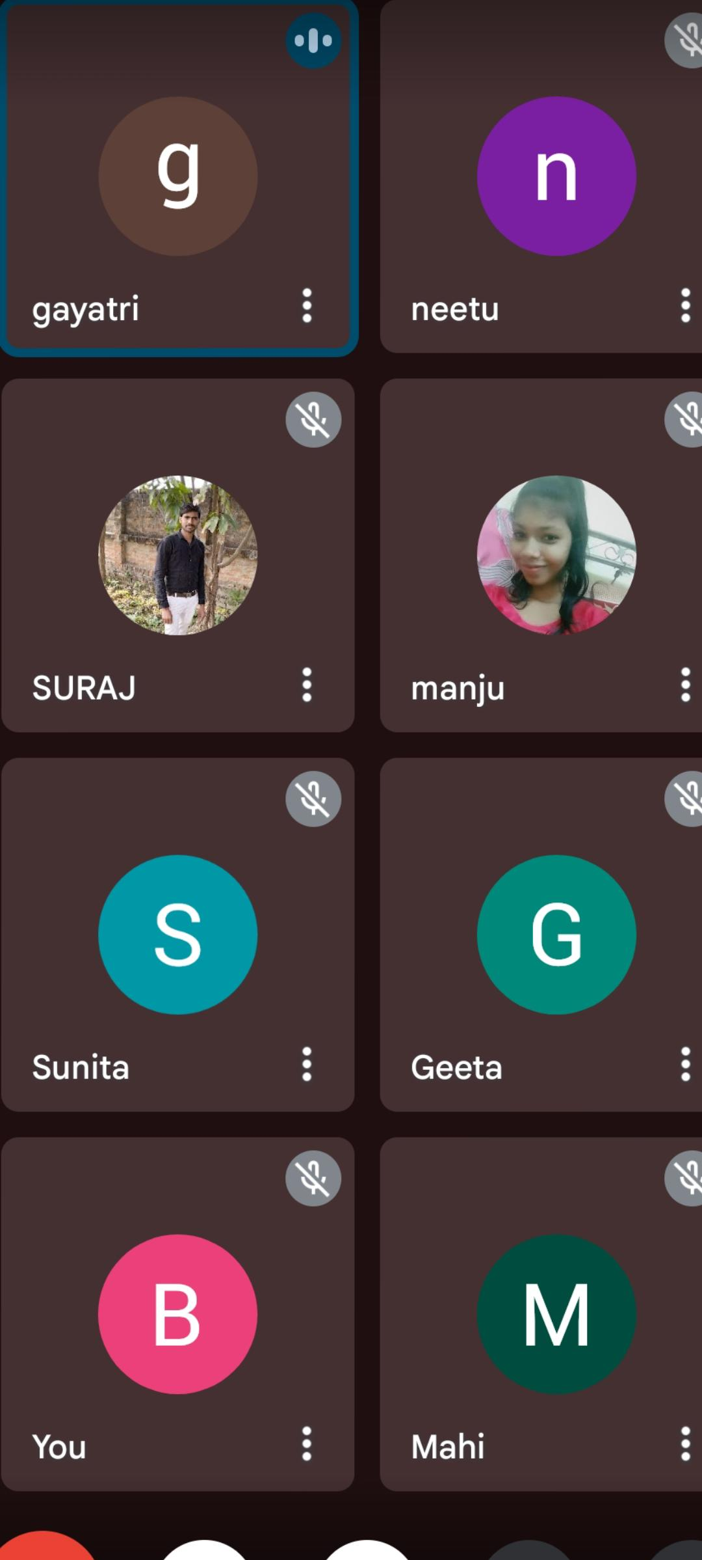
Olivet zone – night prayer
4 night prayer

Slide 5
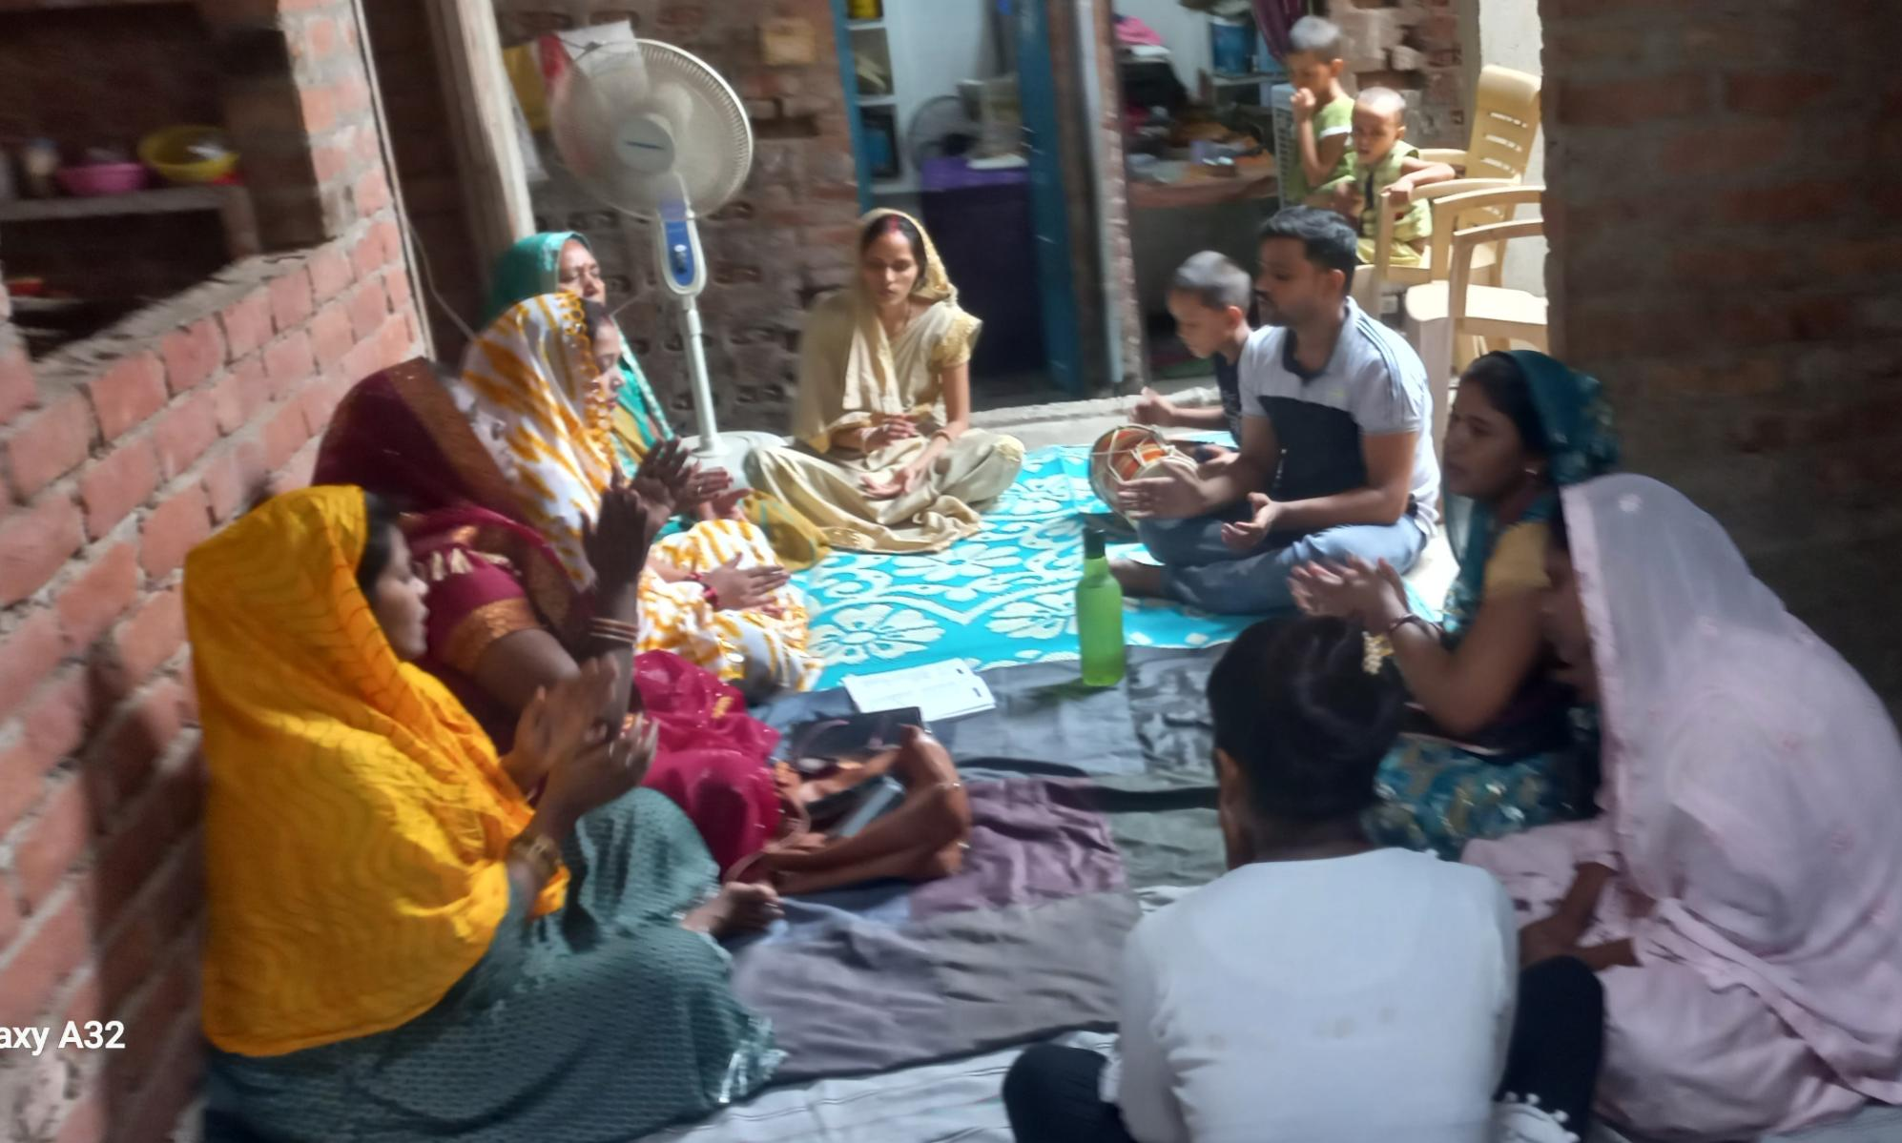
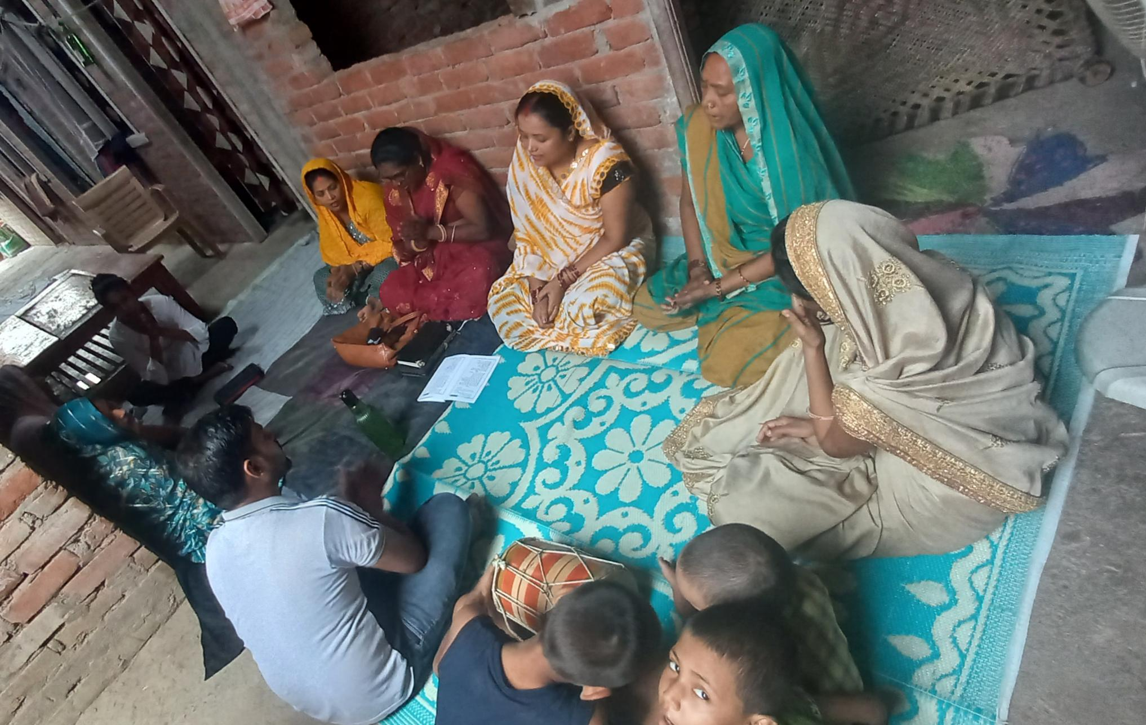
OLIVET zone - fellowship mitting
Fellowship mitting – 02/07/2024

Slide 6
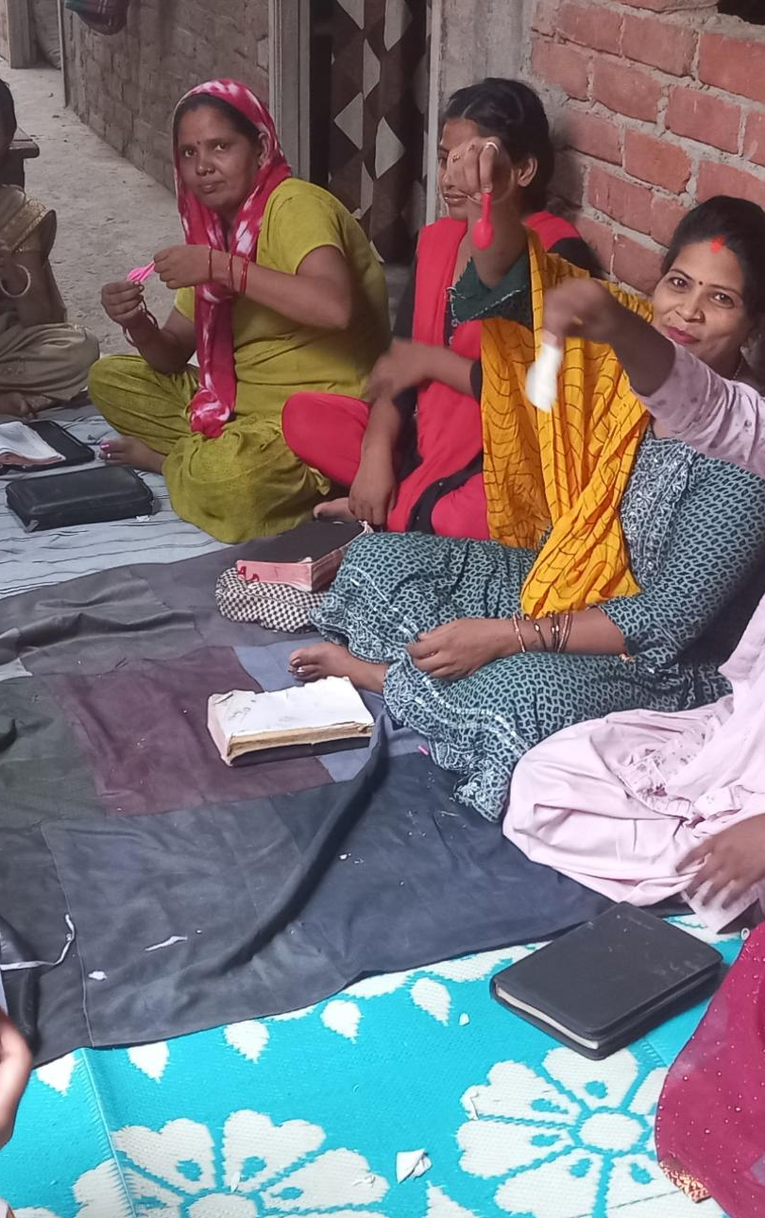
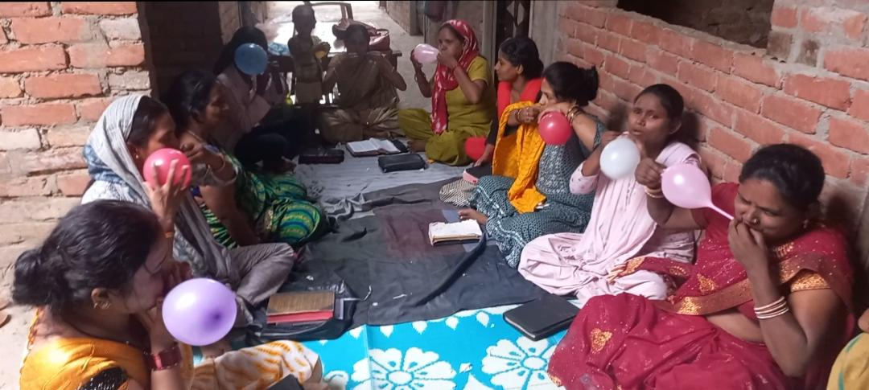
Fellowship mitting

Slide 7
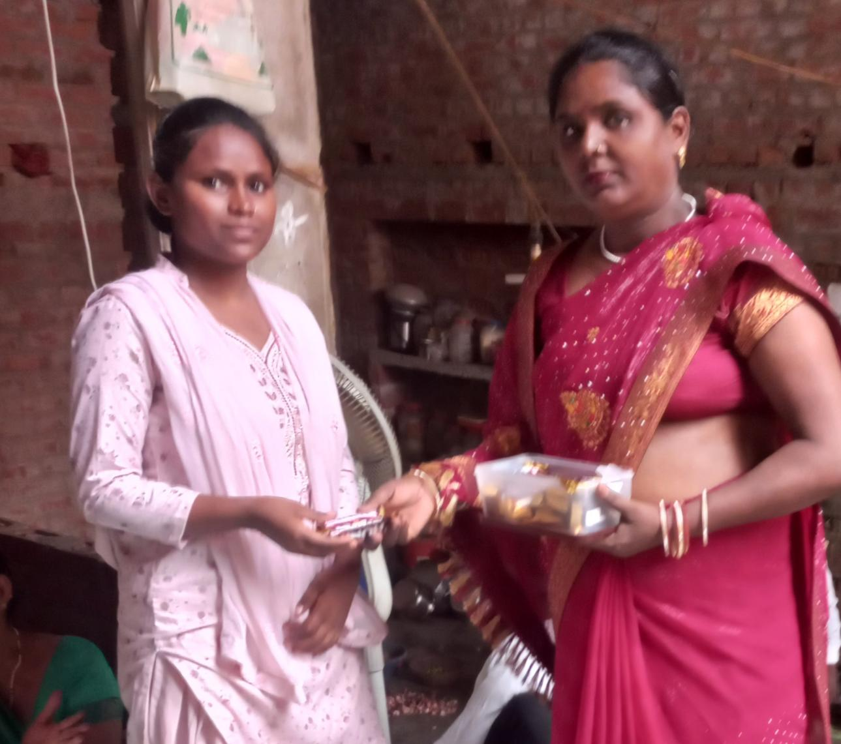
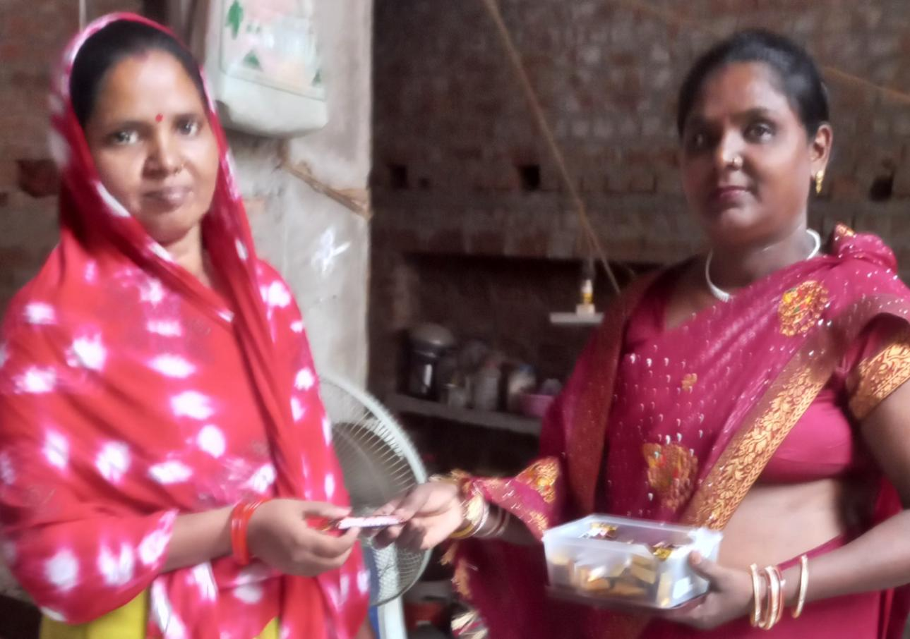
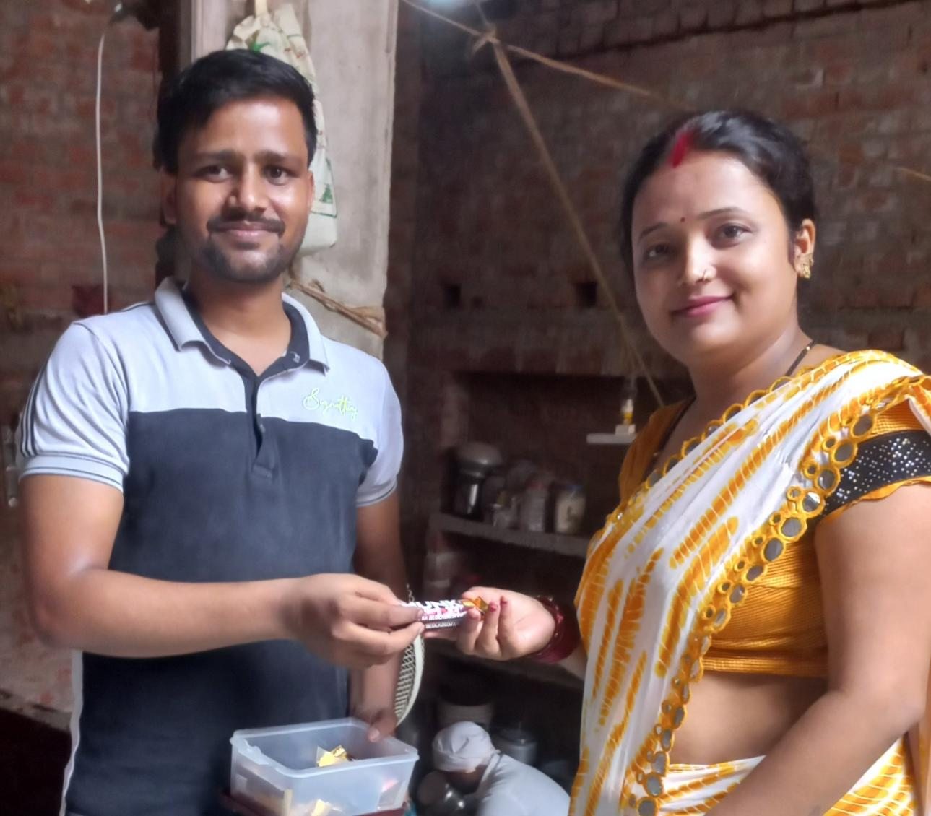
Fellowship mitting
Game

Slide 8
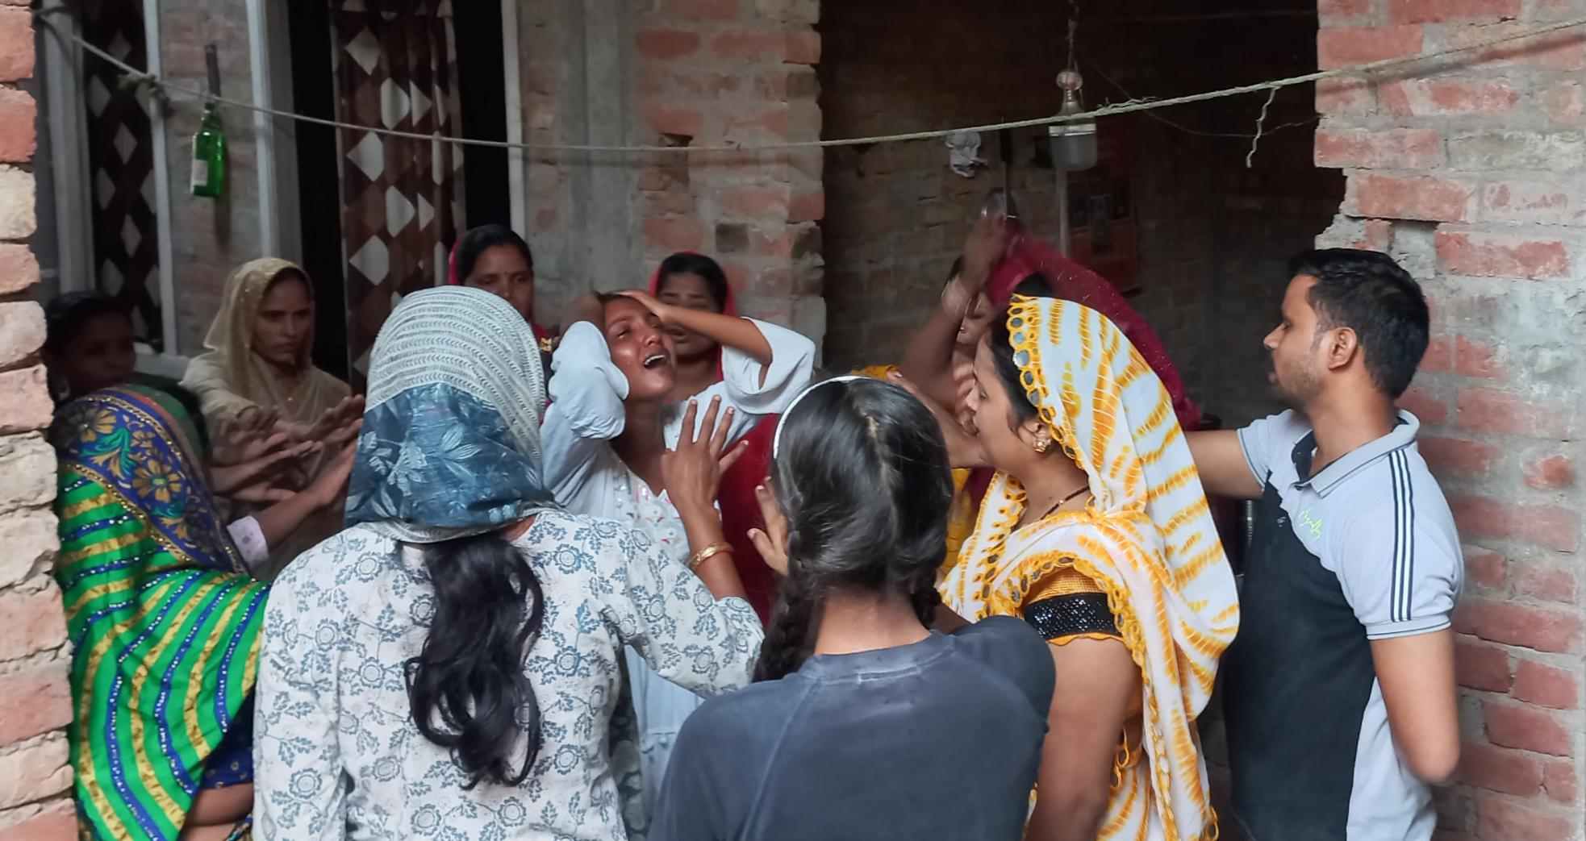
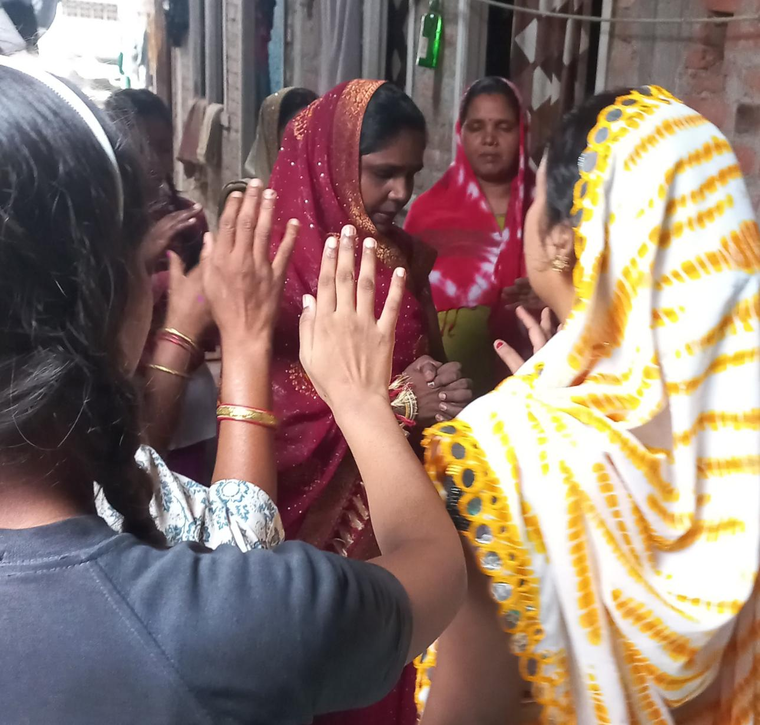
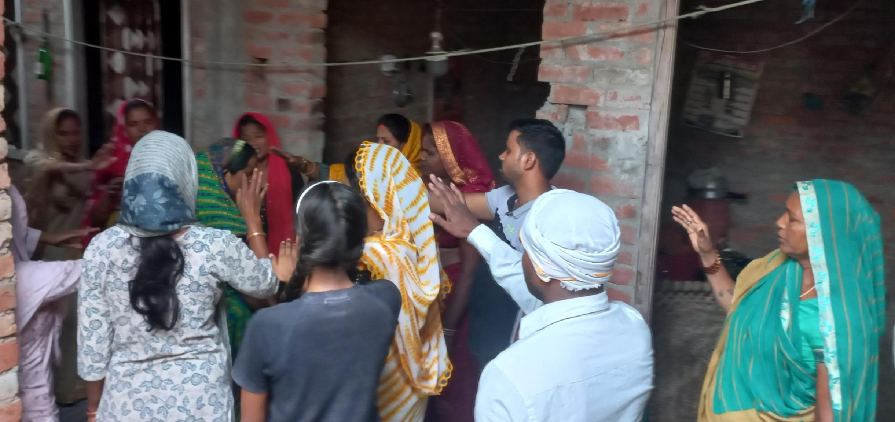
Fellowship - testimonies

Slide 9
Next month plan
Daily morning Worship
4 night prayer
4 troop Church
1 fellowship mitting
One Gift School

Slide 10



