Slide 1
U.P EAST
CENTRAL REGION
HORMON ZONE
Presentation

Slide 2
Word Of God
Psalms 117:1
[1]हे जाति जाति के सब लोगोंयहोवा की स्तुति करो! हे राज्य राज्य के सब लोगो, उसकी प्रशंसा करो!
O praise the LORD, all ye nations: praise him, all ye people.

Slide 3
18 Zones OF U.P
Prayagraj zone
Aligarh zone
Azamgarh zone
Basti zone
Bareli zone
Chitrakut zone
Devipatan zone
Agra zone
Ayodhya zone
Gorakhpur zone
Jhanshi zone
Kanpur zone
Meerapur zone
Lucknow zone
Mirzapur zone
Muradabad zone
Saharanpur zone
Varanasi zone

Slide 4
Core Team Coordinators
State Coordinator- Sol. Bhupendra
Speaker – Sol. Sanjay Kumar
Deputy Speaker –Sol. Vikash
Secretary- Sol. Reema
Shadow Parli Coordinator:- Anita
Bharti
CBS Teacher:- Sangeeta Rai

Slide 5
Zonal Coordinators
Coordinator- Sol. Sangeeta rai
Speaker- Sol. Geeta Rani
Deputy Speaker- Sol. Reena
Secretary- Sol. Usha

Slide 6
SMPs Names
Sol. Sanjay Kumar
Sol. Geeta Rani
Sol. Sangeeta Rai
Sol. Reena Gupta
Sol. Usha
Sol. Nirjala
Sol. Rubi Gupta
Sol. Khushbu Sonkar
Sol. Lalti Devi

Slide 7
Month Planning
Everyday Morning Worship
Five Night Prayer
Two Gift School
Two Shadow Parli
SMPs SMLAs Meeting
Two Troop Church
Every week Children CBS Classes

Slide 8
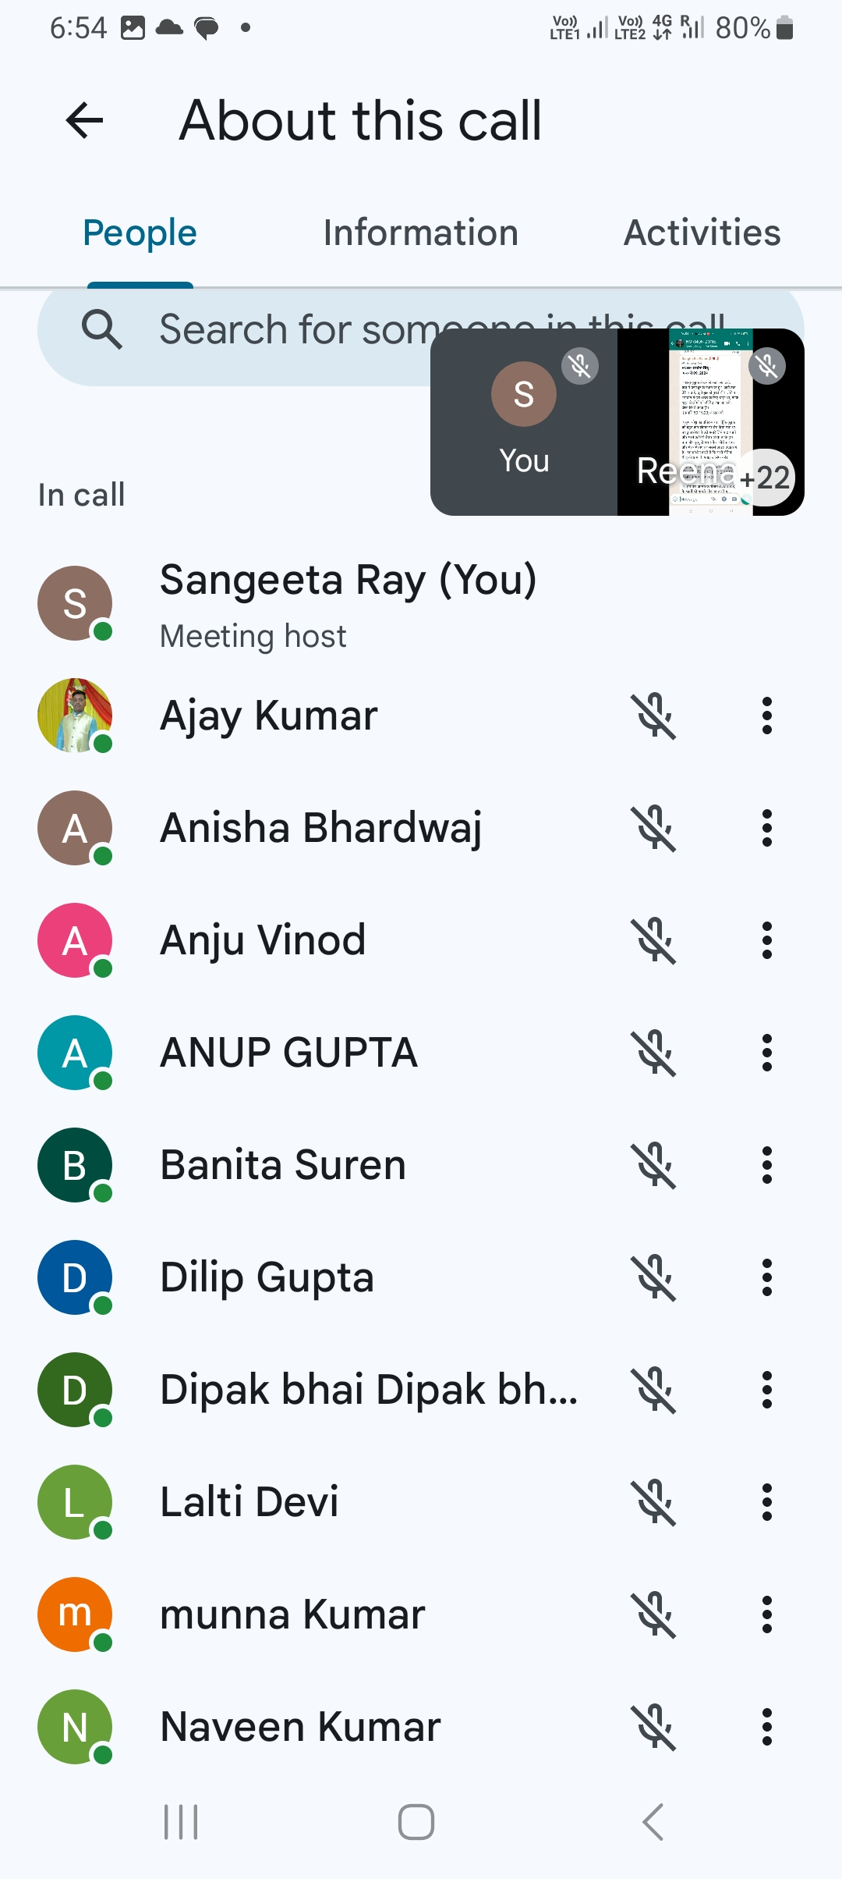
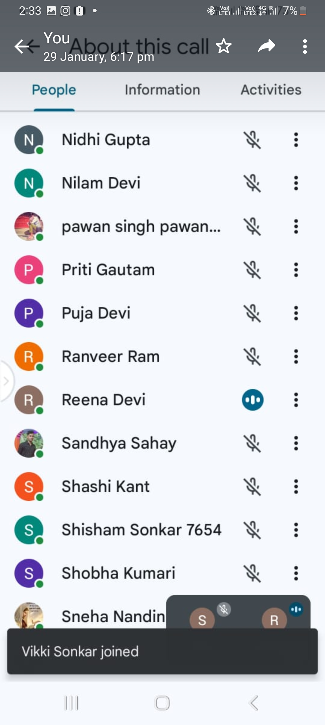
Daily Morning Worship:-
Coordinator:- Mithilesh
Total
28
Members

Slide 9
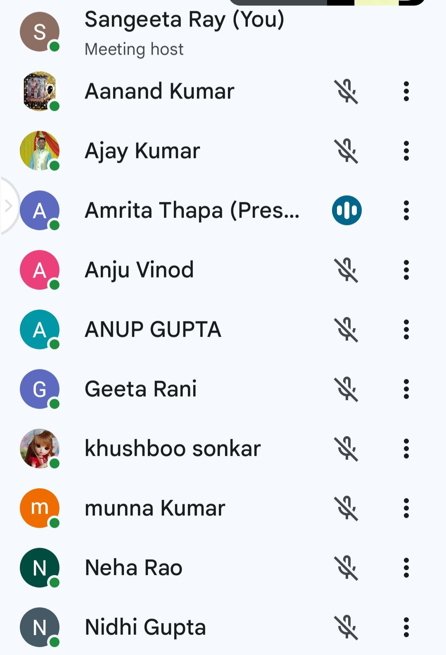
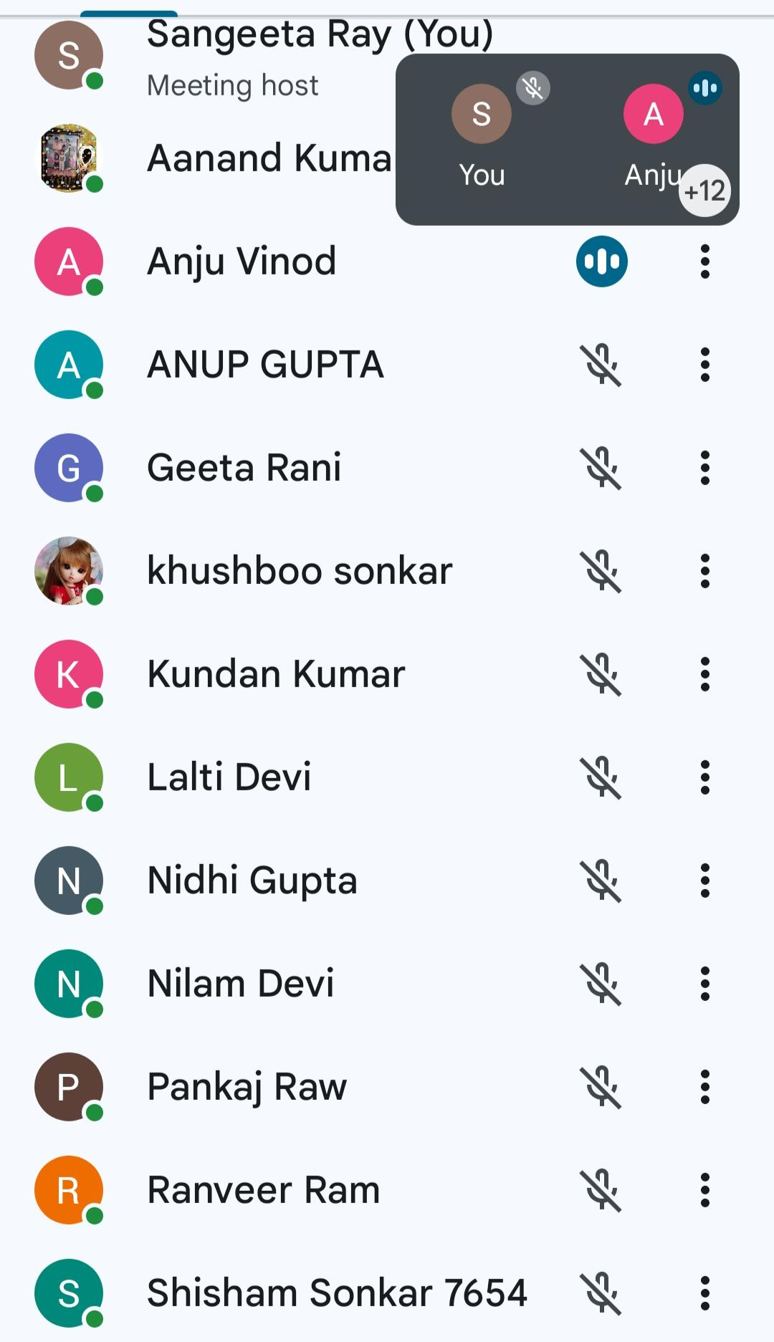
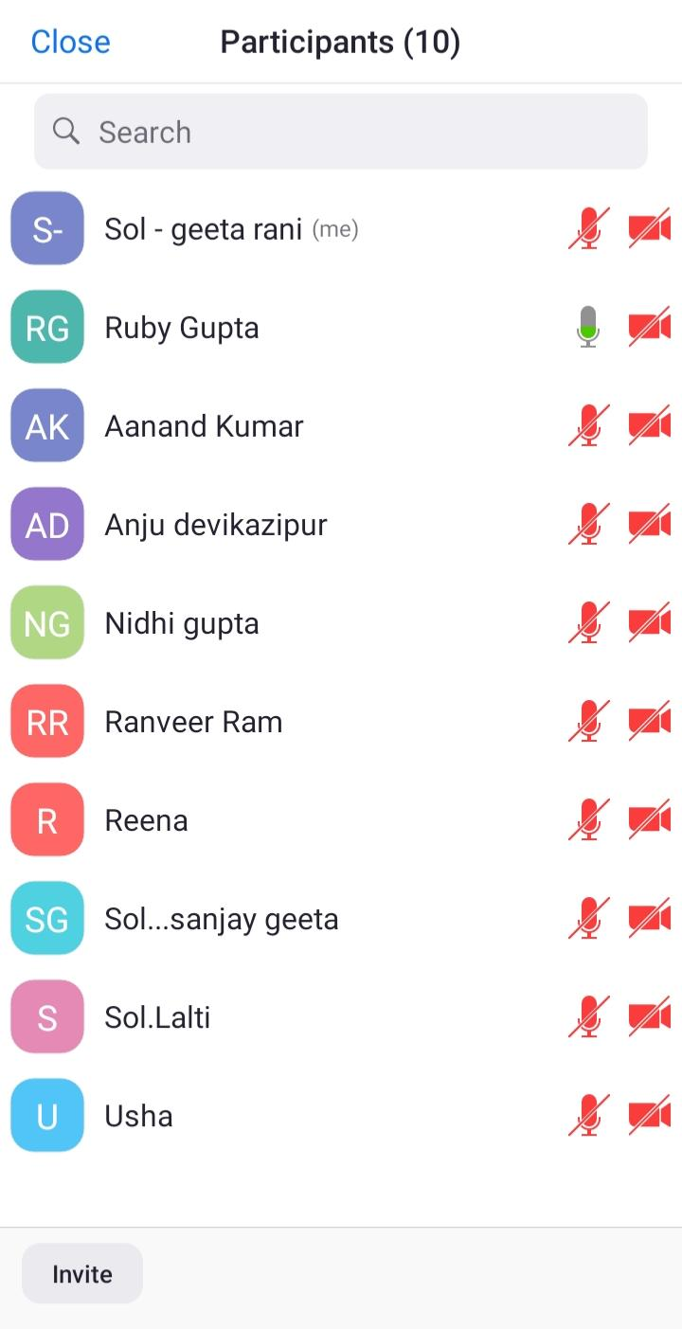
Night Prayer
Date :- 13/1/24 20/1/24
7/1/24 13 members 15 members
10 members

Slide 10
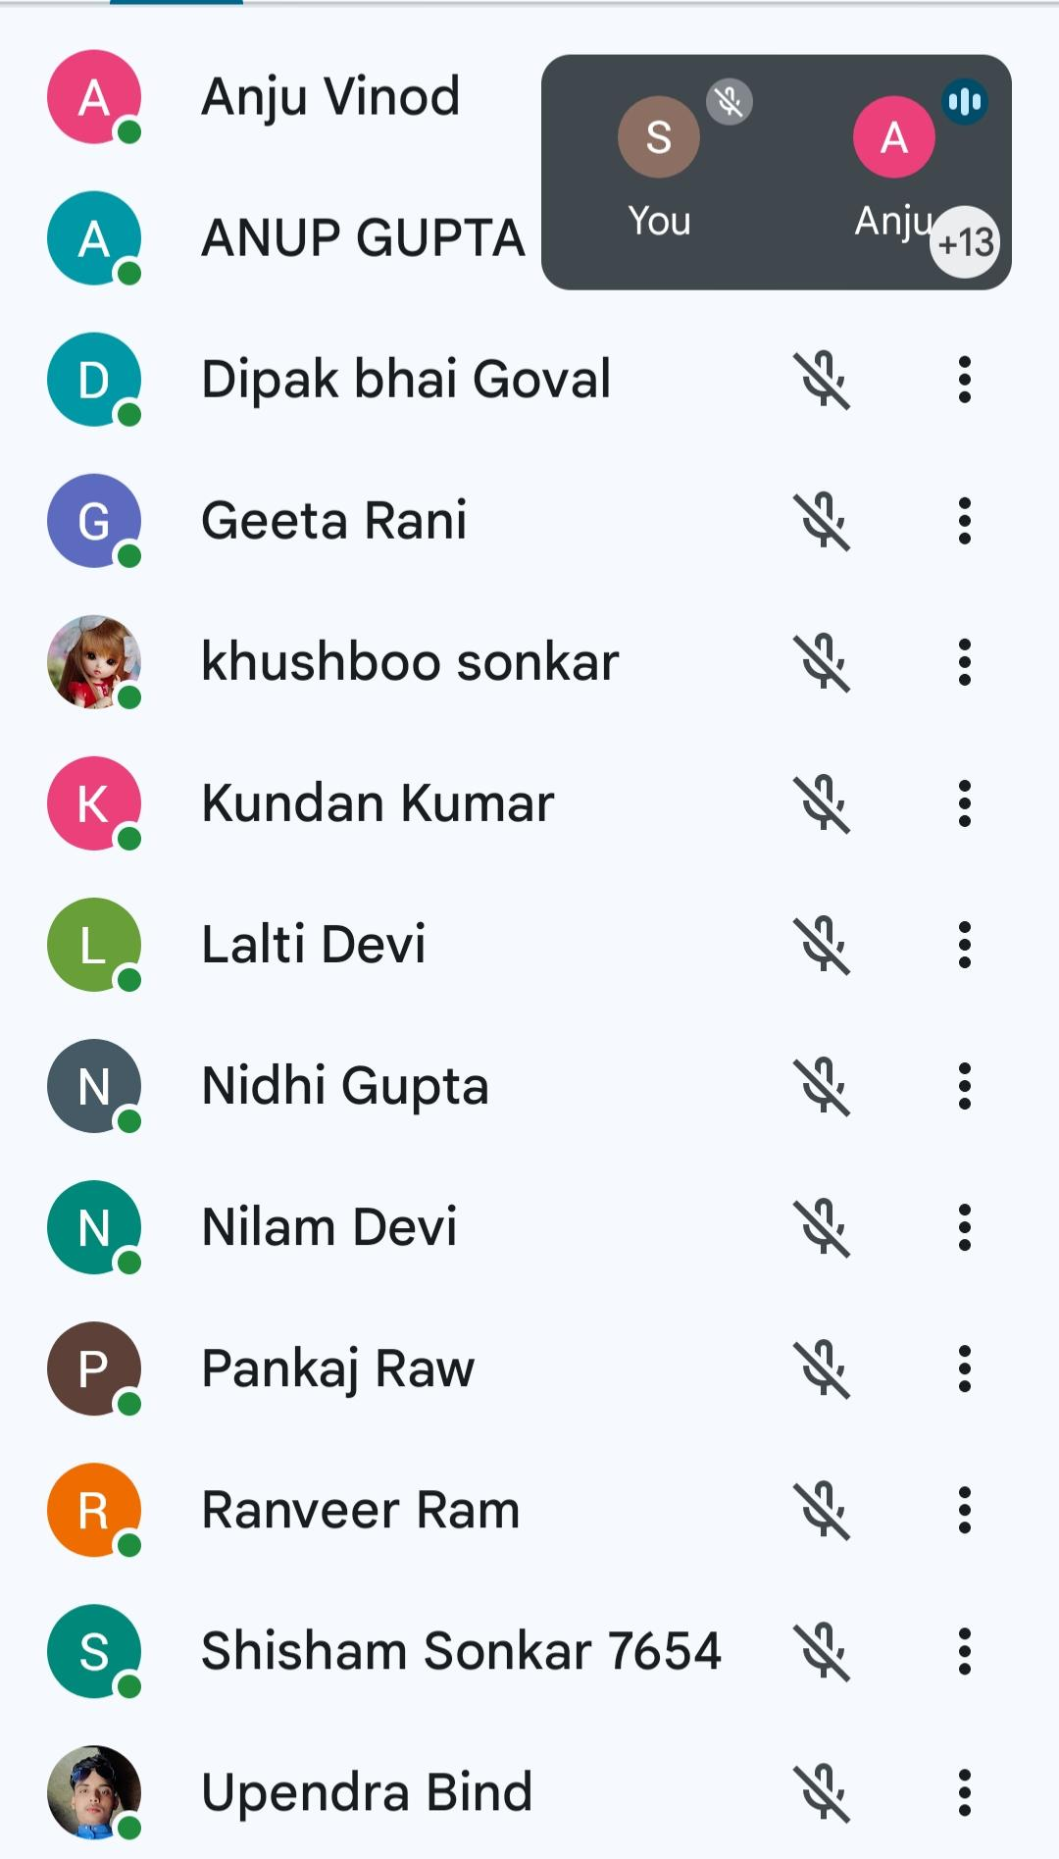
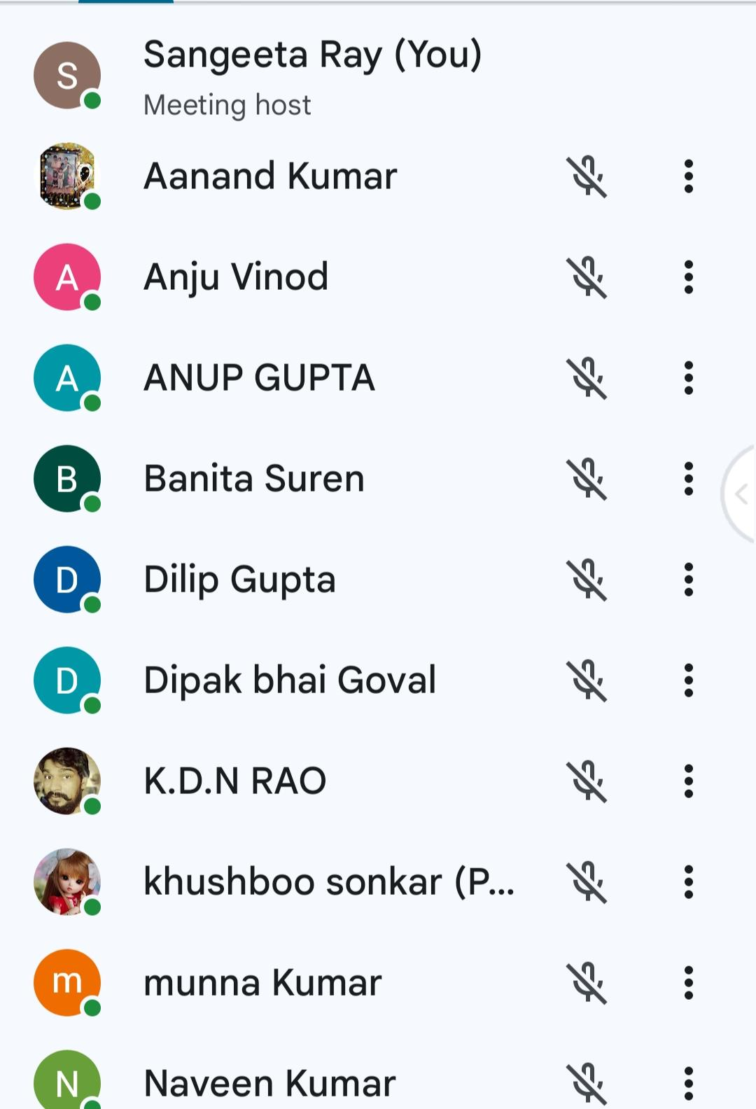
27/1/24. 2/2/24
17 members. 14 members

Slide 11
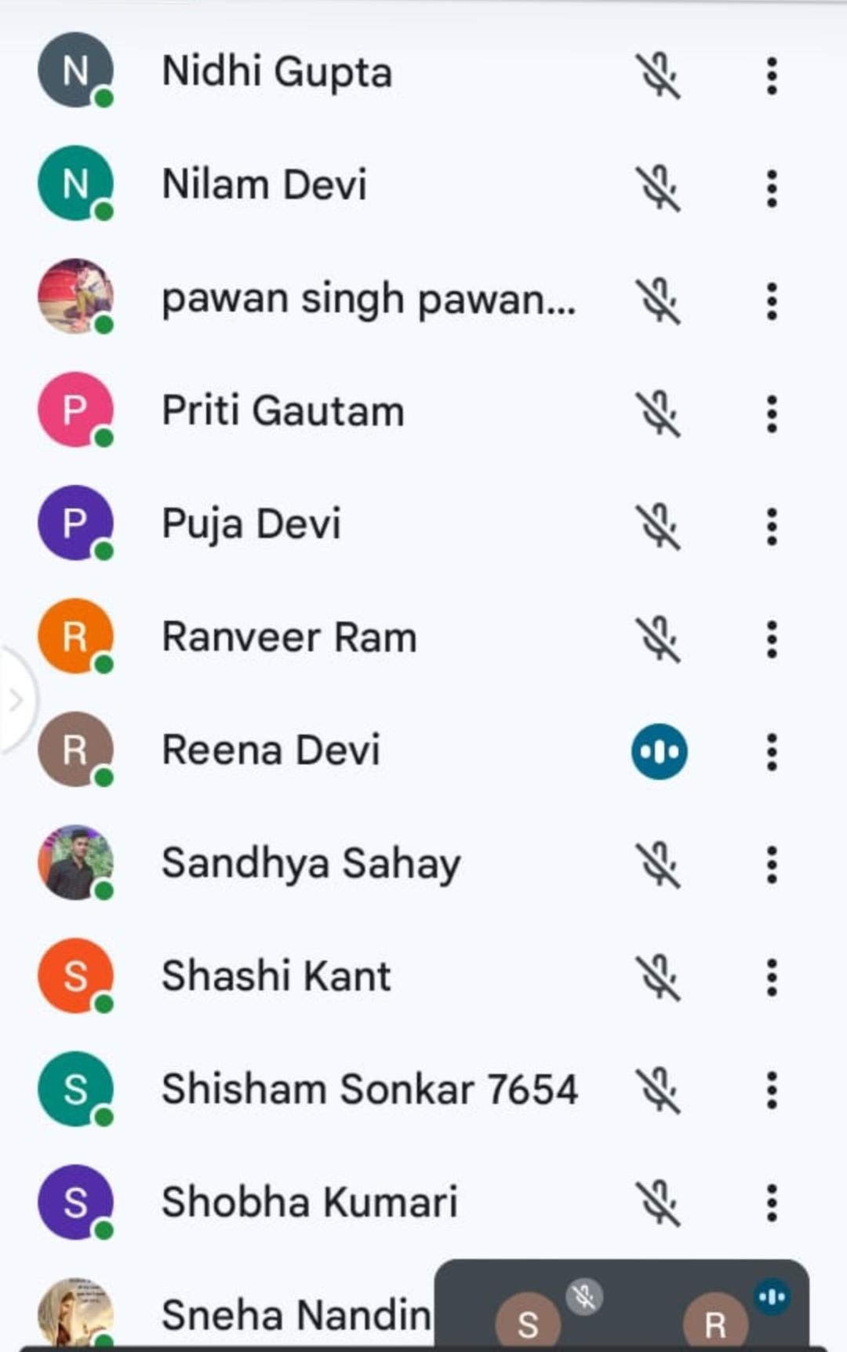
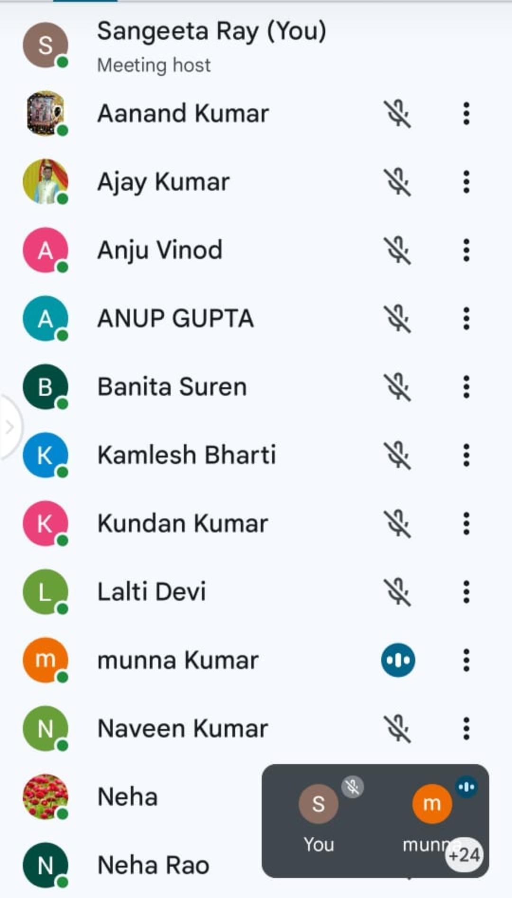
David Worship Gift School
Coordinator:- Reena Gupta
22/1/24 to 29/1/24
Total
28
Students
28

Slide 12
Teachers Name
Sol. Renu Solanki
Sol. Amrita Thapa
Sol. Sangeeta Rai
Sol. Geeta Rani
Sol. Bharti Macwan
Sol. Mini Sibi
Sol. Reena Gupta
Sol. Neha Goel

Slide 13
Ready For Teaching Names
Sol. Nirjala Rao
Sol. Rekha
Sol. Sanjay Kumar
Sol. Usha
Sol. Anju
Sol. Nilam

Slide 14
Ready Coordinators For Gift School
Sol. Sneha
Sol. Rekha
Sol. Lalti

Slide 15
Testimonies In Gift School
Sol. Rekha :- I am Jehovah’s military line. I am from Gujarat. Ever since I joined AOJ, there has been a lot of change in our life and we are being taught a lot by AOJ and we are looking for God and we have come closer to God. Ameen
Sol. Nillam:- I am Yahova’s Soldier Neelam Pratapgarh I and my family are suffering from evil spirits and we are facing a lot of trouble due to it. Ever since we have joined AOJ, we have got a lot of peace and have got rid of the evil spirits, that is why we thank God, Ameen.

Slide 16
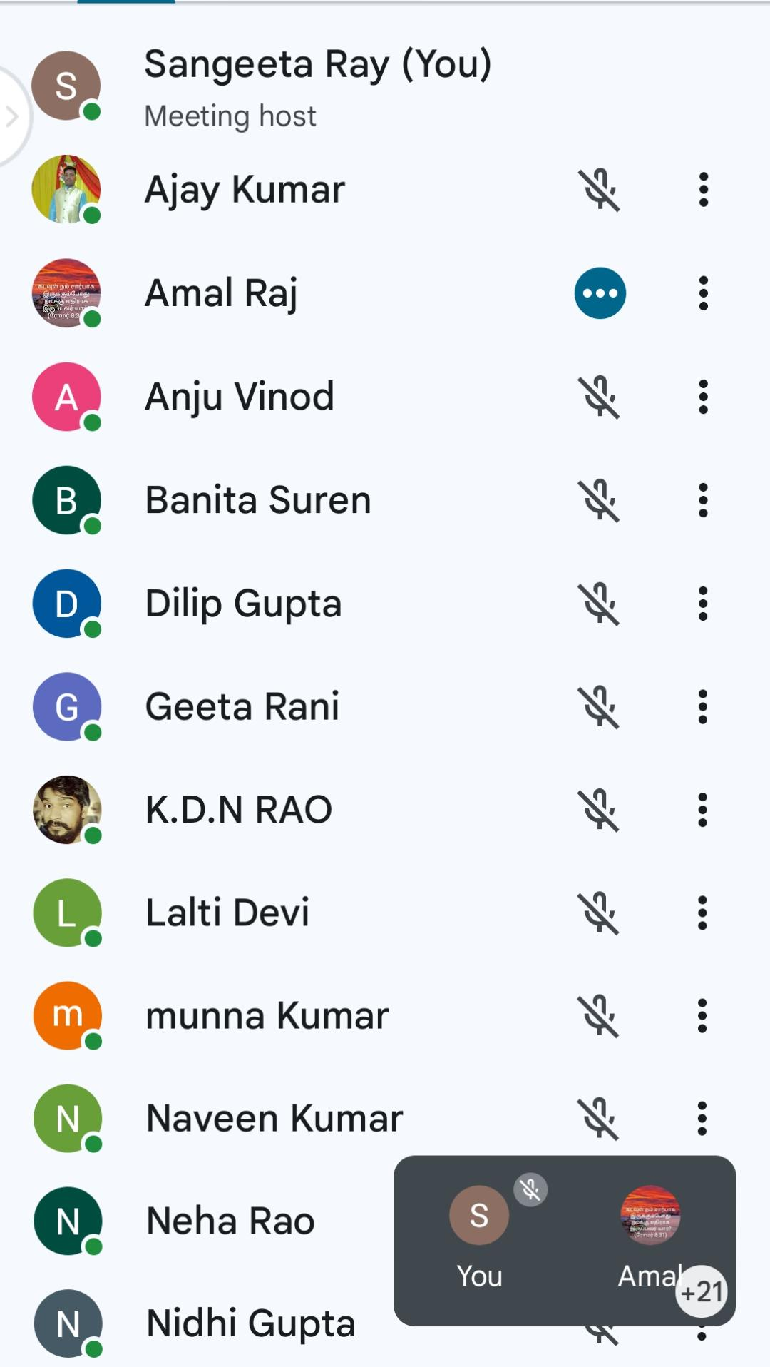
Zone Shadow Parli Meeting
Total :- 25 members
Date:- 28/1/24.
Time:- 5:30am to 7:30am
Topic:- Ayodhya Ram Temple Idol Worship
Words of God Come from Shadow Parli Prayer :-
Jeremiah 38:3-4
[3]यहोवा यों कहता है, यह नगर बाबुल के राजा की सेना के वश में कर दिया जाएगा और वह इस को ले लेगा।
Thus saith the LORD, This city shall surely be given into the hand of the king of Babylon’s army, which shall take it.
[4]इसलिये उन हाकिमों ने राजा से कहा कि उस पुरुष को मरवा डाल, क्योंकि वह जो इस नगर में बचे हुए योद्धाओं और अन्य सब लोगों से ऐसे ऐसे वचन कहता है जिस से उनके हाथ पांव ढीले हो जाते हैं। क्योंकि वह पुरुष इस प्रजा के लोगों की भलाई नहीं वरन बुराई ही चाहता है।
Therefore the princes said unto the king, We beseech thee, let this man be put to death: for thus he weakeneth the hands of the men of war that remain in this city, and the hands of all the people, in speaking such words unto them: for this man seeketh not the welfare of this people, but the hurt.

Slide 17
Date :- 6/2/2024
State Shadow Parli Meeting :-
Coordinator:- Anita
Date:- 6/2/24
Time:- 8pm to 9:30pm
Topic:- Idol Worship Life Prestige
WORD OF GOD Come from Shadow Parli Prayer:-
1 Kings 8:14-15
[14]और राजा ने इस्राएल की पूरी सभा की ओर मुंह फेरकर उसको आशीर्वाद दिया; और पूरी सभा खड़ी रही।
And the king turned his face about, and blessed all the congregation of Israel: (and all the congregation of Israel stood;)
[15]और उसने कहा, धन्य है इस्राएल का परमेश्वर यहोवा! जिसने अपने मुंह से मेरे पिता दाऊद को यह वचन दिया था, और अपने हाथ से उसे पूरा किया है,
And he said, Blessed be the LORD God of Israel, which spake with his mouth unto David my father, and hath with his hand fulfilled it, sayingTo
Total 24 members

Slide 18
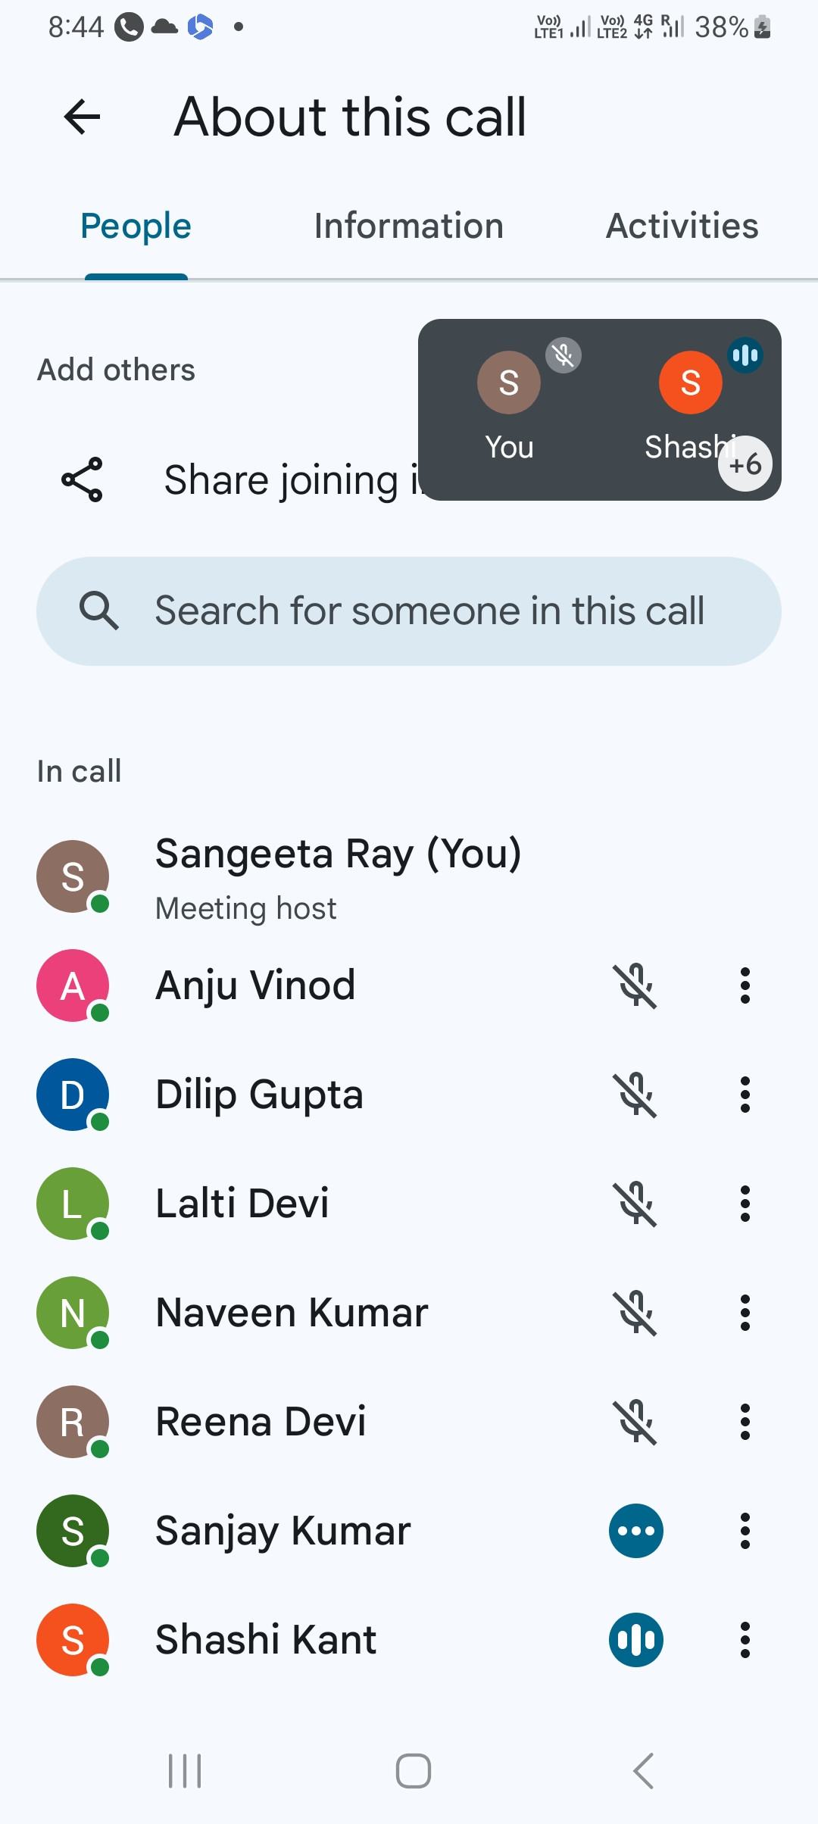
SMPs SMLAs Meeting:-
Date:- 9/2/24
Total Participants:- 8

Slide 19
CBS Classes:-
Teacher:- Sangeeta Rai
Date:- 10/2/24
Time:- 4pm To 5:30pm
Total Participants:Sol. Anshika
Sol. Lado
Sol. Joy.

Slide 20
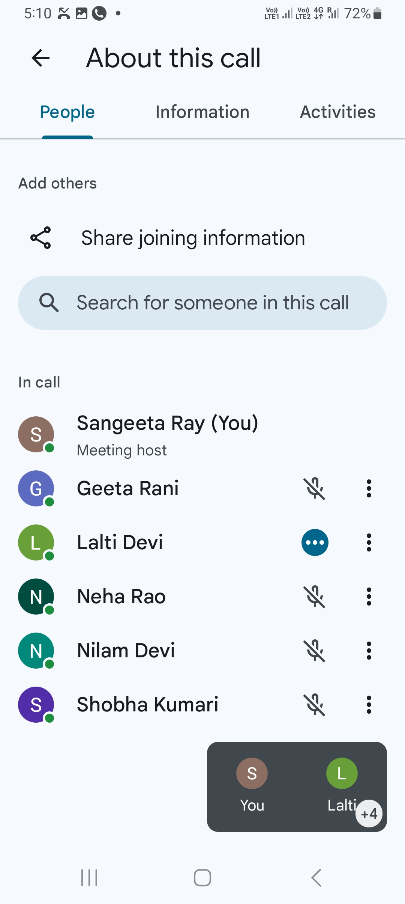
Sol. Akriti
Sol. Angel
Sol. Anugrah
Sol. Aryan
Sol. Arpit
Sol. Ansh Kumar
Sol. Subham
Sol. Shekhar
Total :- 12 members

Slide 21
Troop Church:-
Troop church name:- Yahoshu
Leader:- Geeta Rani
Date:- 2/2/24
Participants:- 11 members

Slide 22
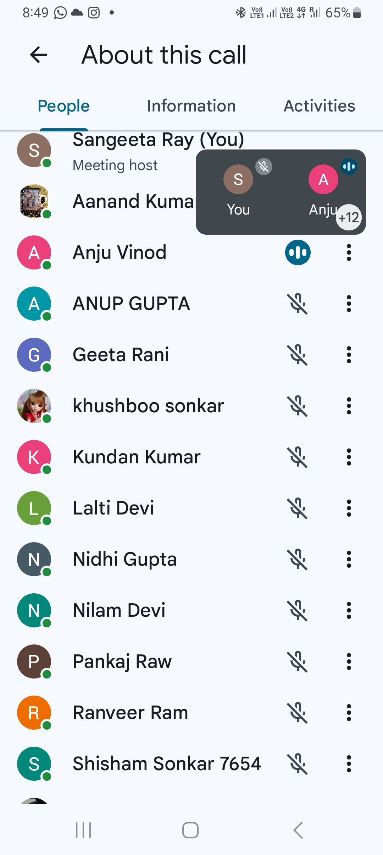
Night Prayer:-
Date:- 10/2/24
Participants:- 13members

Slide 23
Thank
You

