Slide 1

Regional Monthly
Prayer Meet
UP | 08.09.2021

Slide 2
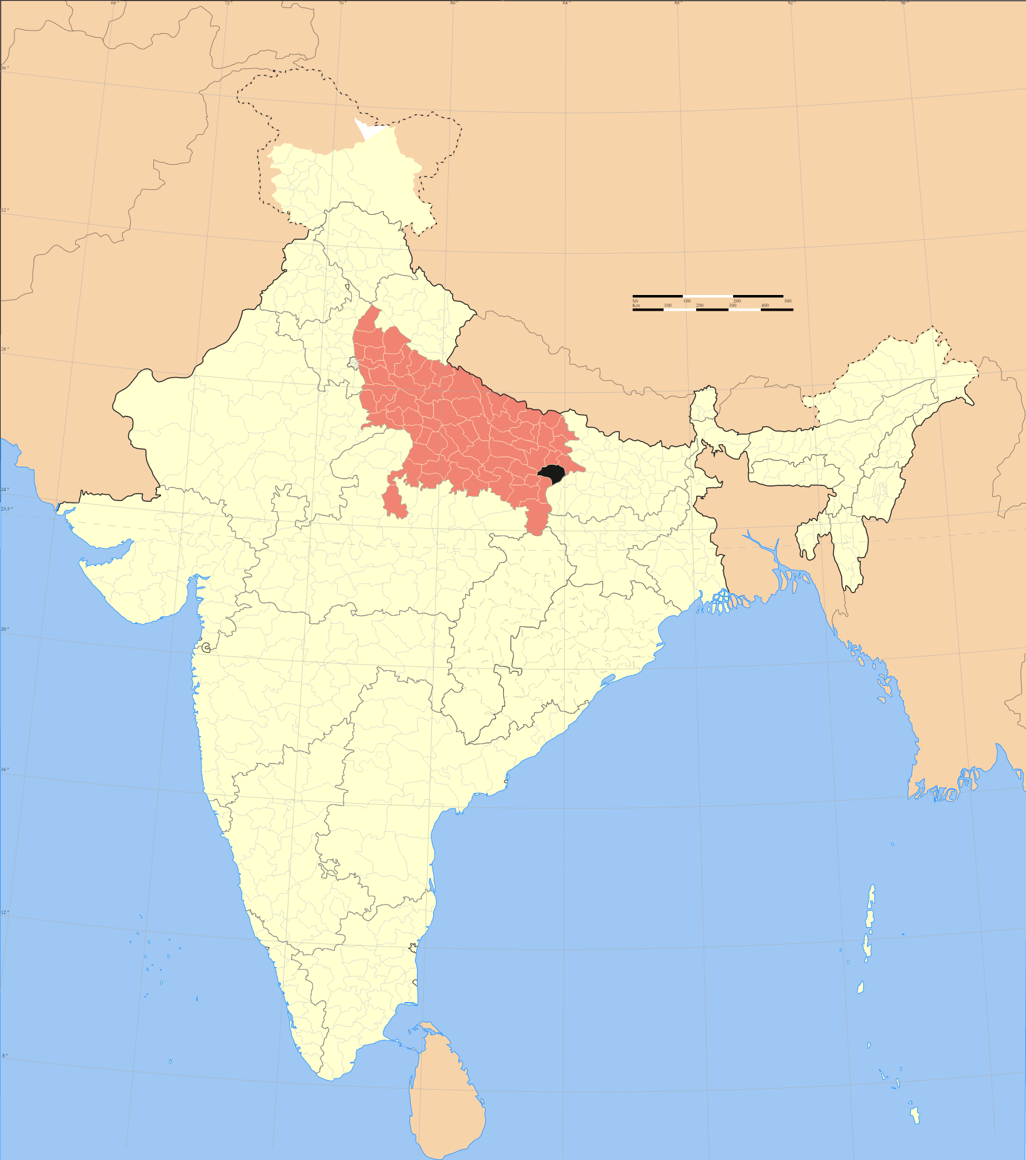
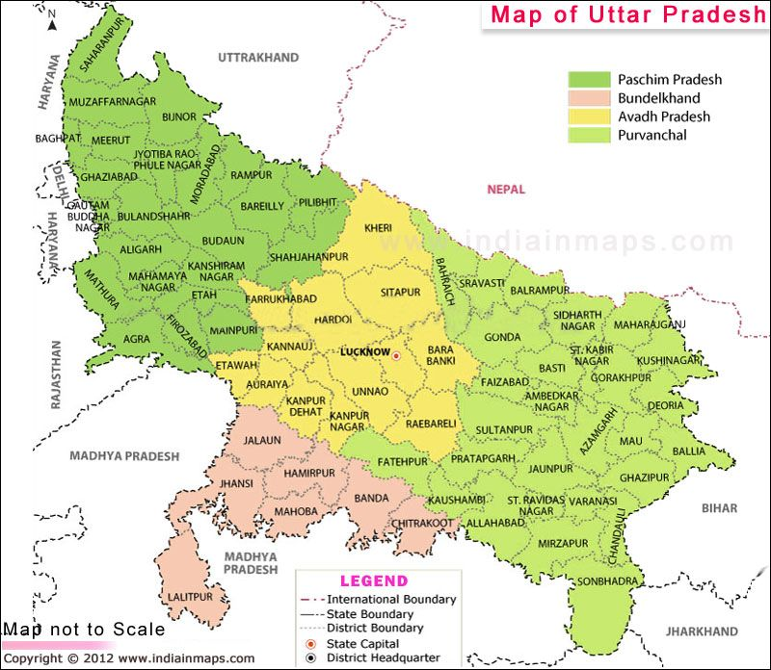

Slide 3

Report :
troop church
MONTH : JULY & AUGUST

Slide 4
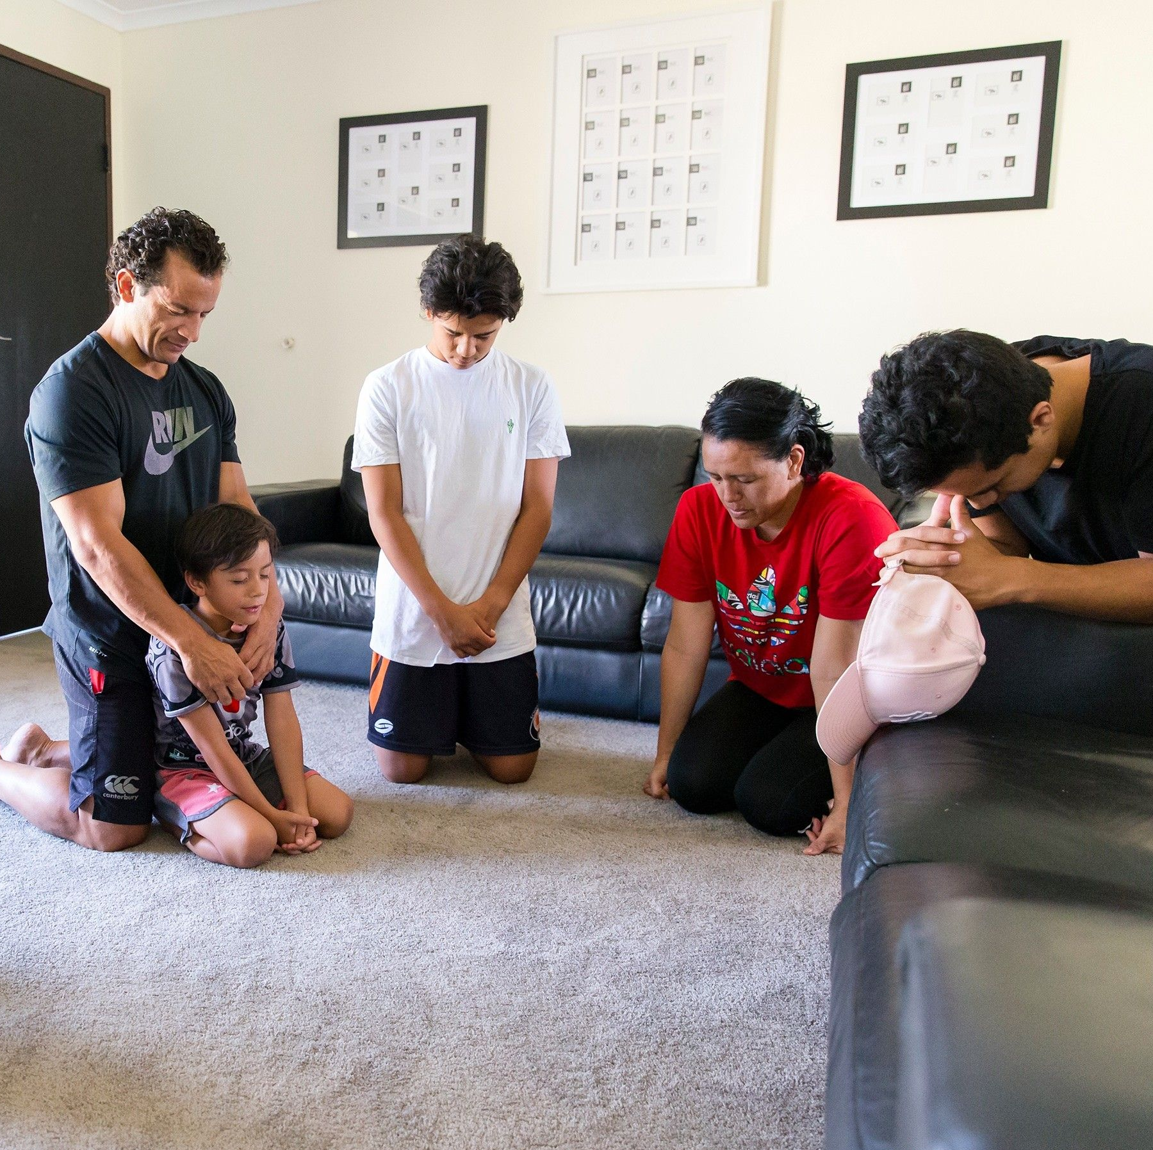
Six Troop Churches Have Started
The names are as follows :
Joshua
Jehovah Jireh
Martha
Markus
Psalms
Nehemiah
And let us consider how we may spur one another on toward love and good deeds, not giving up meeting together, as some are in the habit of doing, but encouraging one another—and all the more as you see the Day approaching. Hebrews 10:24-25

Slide 5

Troop church | Troop Leaders
1) Sol. Anchal
2) Sol. Rachel
3) Sol. Sudha
4) Sol. Kamlesh
5) Sol. Sangeeta Rai
6) Sol. Ashok
“Let nothing be done through selfish ambition or conceit, but in lowliness of mind let each esteem others better than himself. Let each of you look out not only for his own interests, but also for the interests of others.”
Philippians 2:3-4

Slide 6

Report :
be formed and form
Month : August (9th to 27th August 2021)

Slide 7


August (9th to 27th August 2021)
BFF | Co-ordinator's list
BFF
Sol.Jannet Lawrence
Sol.Sudha Kamlesh
Duration - 17 DAYS
Sol.Kamlesh Sudha
Sol.Sangeeta Rai

Slide 8

BFF | Teacher's list
Sol.Sibi
Mother Leema Rose
Sol.Sr.Angelica
Sol.Lissy
Sol.Theresa Cabral
Sol.Jannet
Sol.Veena
Sol.Sibi p.M
Sol.Luiza
Sol.Charan
Sol.Mini
Sol.Shebe lalu
Sol.Ajay pal
Sol. Jasmin

Slide 9
BFF | Participant's list Interested In
Teaching/Organising And Co-ordinating/Smps
Sol.Ashok Dass
Sol.Sanjay
Sol.Kamlesh Sudha
Sol.Saraswati Dass
Sol.Sudha Kamlesh
Sol.Sarita
Sol.Sangeeta Rai
8. Sol.Shushila
9. Sol.Maya Sarkar
10. Sol.Suman (Azam)
11. Sol.Anchal
12. Sol.Suman(noida)
13. Sol. Rechal
14. Sol.Kamlesh
15. Sol.Geeta

Slide 10
BFF | Summary
By The Grace Of God And With The Presence Of The Holy Spirit, Online BFF Training Was Conducted In U.P East And Was Successfully Completed With 57 Students
57
48
09
Total Students
Online
Conference

Slide 11

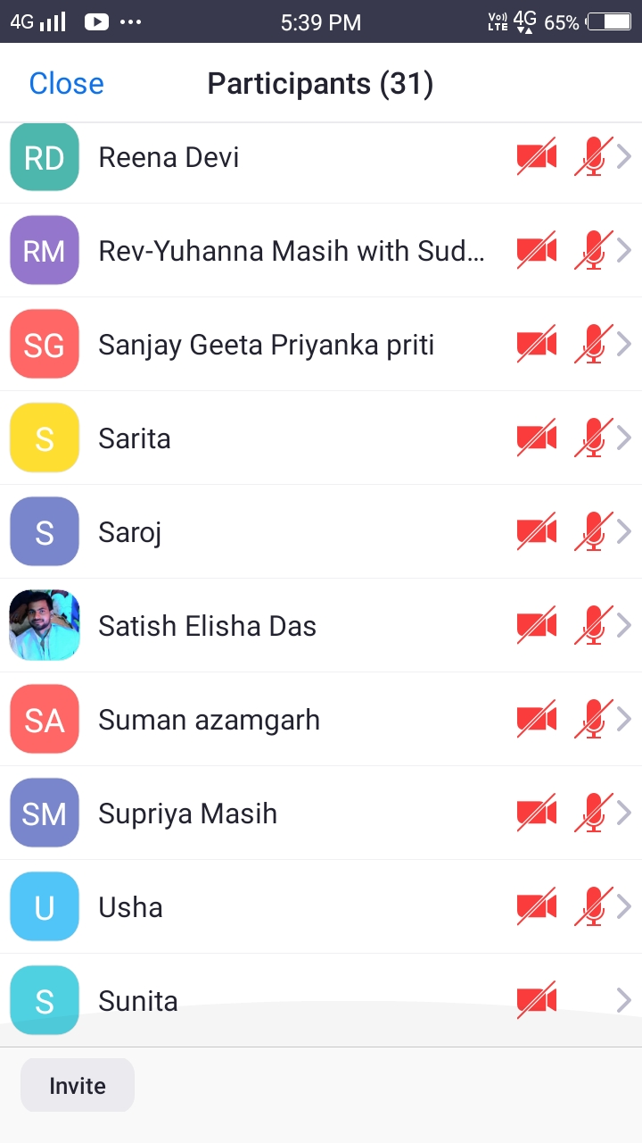
Participants: 31+20 in other mobile

Slide 12
BFF | Testimonies
1
2
3
Ten new people accepted Lord Jesus as their saviour and now want to take baptism. Amen
Name - Saraswati Dass
She was unable to live without an inhaler pump, but now she is delivered from her breathing problem as well as from arthritis. Amen.
Name - Dherinder
He had an encounter with God and later he himself proclaimed that, "I want accept the Lord as my saviour." Amen.
4
5
6
Name - Sangeeta Rai
During anointing she was anointed with oil ,and an angel came and put a new white robe
Name - Ashok Dass
During the anointing session, he felt the anointing to such an extent that he started crying and was not able to stop crying.
Name – Manoj
He got delivered from an evil spirit and accepted the Lord Jesus as his saviour.

Slide 13

BFF | Testimonies
7
8
Name - Maya Sarkar
At the time of anointing, she was experiencing the vision of crucifixion of Christ and she started crying and she felt pain in her body.
Four children received the holy spirit during anointing.

Slide 14
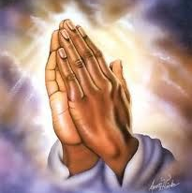
Special Thanks to
Mother Leema Rose
Sol.Angelica
Sol.Luiza
Sol.Sibi
Sol.Mini
Sol.Jasmine
Thank you so much for your support and help!
Glory to jesus.

Slide 15
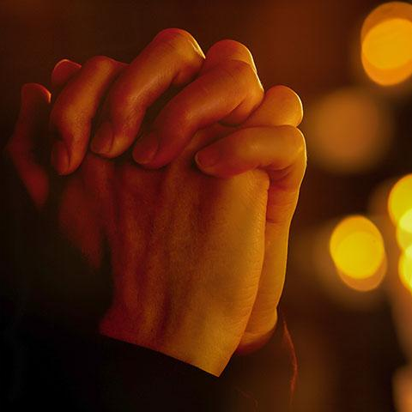
Special Thanks
First and foremost, we are very thankful to God for His protection, encouragement and guidance in every situation.
We are thankful to the entire AOJ north team and the coordinators of the west for arranging the teachers for us.
We are also thankful to all our soldiers who helped us in the chain prayer.
And we are thankful to all our participants.

Slide 16

Report :
Morning worship –
BIHAR
Started : 23rd August , 5:30 am to 7 am

Slide 17
Report :
Morning worship –
UP | Jehovah Jireh
Started : 31st May 2021
Members : 33

Slide 18
Morning Worship | Testimonies
1
2
3
Sol. Sangeeta Ray : Praise God, I am soldier of AOJ,U.P.(Varanasi)I thank the Lord, that as I have joined in the morning worship, Lord blessed me so much that, I could come out from shyness, solved all my problems, my family which was broken now by the God’s grace it's been united. helped me to grow in my spiritual life. The knowledge, boldness which I have received, I could not get from the past days, but I could learn and grow so much in past 4 month. Amen! Alleluia
Sol. Nirjala Rao : I am Nirjala Rao and my husband's name is Mr. Sashikant Rao, past two month I am joining it regularly and in one the day I got healed from my sickness, which was related to ladies, and I was suffering from past 5 years, but God touched me and healed me ,and now I believe that I will be also blessed with a child ,where doctors said I will never be a mother. Thank you and God bless you all.
Sol. Manju : I am Manju my son was so sick, but regularly coming in this morning worship meeting my son got healed and even my whole family started believing in Jesus. Praise God.

Slide 19
Plan for September
1
2
3
4
5
TROOP CHURCHES planned at Bakhariya (Ara) Bihar.
Night Prayer – 18 September at Sukhrauli (Village), Bhojpur.
Carrying out regular worship & warfare prayer for constituencies
Fasting Prayer – September 2020
Healing class is planned for this Month

Slide 20
Plan for September
There are 41 S.M.P and 28 SMLA region in eastern UP
The coordinator of Jehovah Jireh morning worship is Sol. Sangeeta Rai and sub coordinator- Jannet Lawrence.
40 to 45 Members used to attend Daily morning worship.
On 31st May 2021, JEHOVAH JIREH morning Worship in Uttar Pradesh.
Planning to start new morning worship after 3 months in Bihar.

Slide 21

Report :
24 HOURS –
OFFLINE WORSHIP
Planning and praying

Slide 22

Report :
24 HOURS –
ONLINE WORSHIP
Planning and praying

Slide 23
Report :
NATIONAL WORSHIP
CENTRE
Planning and praying

Slide 24

Report :
PAUL SCHOOL OF DELIVERANCE
Planning and praying

Slide 25
Report :
BETHESDA SCHOOL OF HEALING
Planning and praying

Slide 26
Report :
DAVID SCHOOL OF WORSHIP
Planning and praying

Slide 27
Report :
SAPPHIRE UNIVERSITY
Planning and praying

Slide 28
Report :
JEREMIAH SCHOOL OF PROPHECY
Planning and praying

Slide 29
Report :
MARTHA SCHOOL OF HOSPITALITY
Planning and praying

Slide 30
Report :
NAZRETH SCHOOL OF FAMILY BUILDING
Planning and praying

Slide 31
Report :
MARTHA SCHOOL OF HOSPITALITY
Planning and praying

Slide 32
Report :
JOSEPH SCHOOL OF FINANCIAL DISCIPLINE
Planning and praying

Slide 33
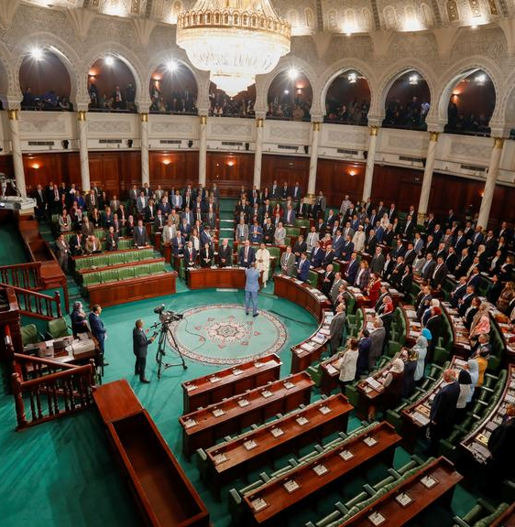
Report :
SHADOW PARLI
Planning and praying

Slide 34

Report :
TRAINING FOR TRANSLATIONS
Planning and praying

Slide 35
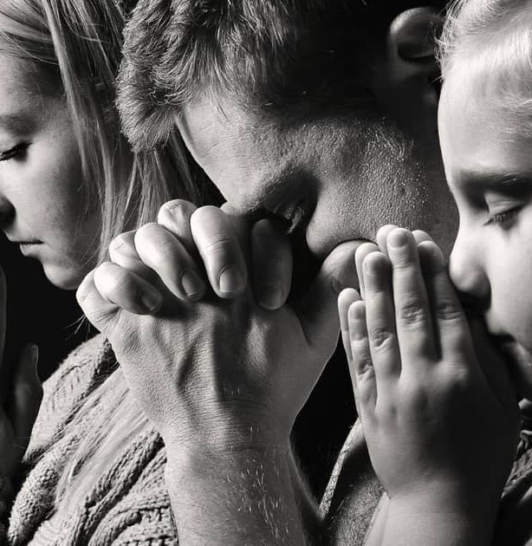
Report :
NIGHT PRAYER
Planning and praying

Slide 36

Report :
BERYL WING
Planning and praying

Slide 37

Report :
CHILDREN BIBLE SCHOOL
Planning and praying

Slide 38

Report :
MATRIMONY
Planning and praying

Slide 39

Report :
ESHCOL COUNSELING COURSE
Planning and praying

Slide 40

Report :
IT WING
Planning and praying

Slide 41

Report :
FUNERAL SERVICE
Planning and praying

Slide 42
Thank You
PLEASE CONTINUE TO PRAY FOR
UTTAR PRADESH
BIHAR
MADHYA PRADESH

